Slide 1
AUTOMATIC PLANT WATERER
YUNUS EMRE SELEN
151220202061
ESKISEHIR OSMANGAZI UNIVERSITY

Slide 2
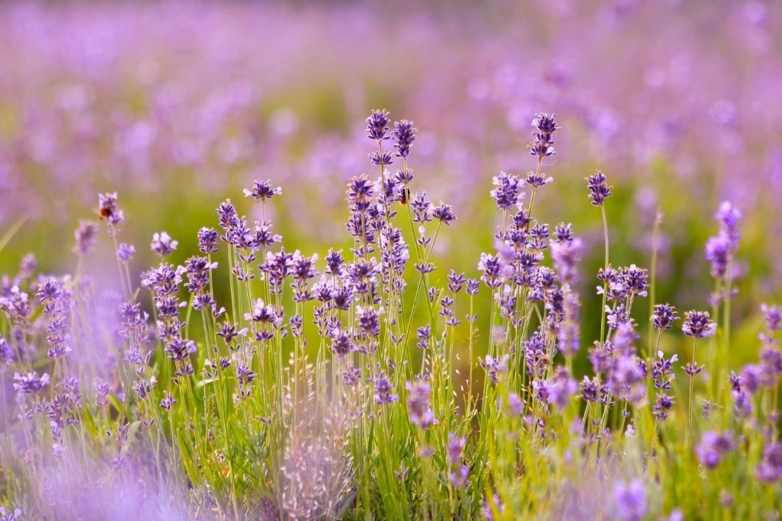
What is the Plant?
Plants are a very large realm of living things that can produce their own food by photosynthesis and contain many organisms such as trees, shrubs, flowers, grasses, mosses, etc.
https://tr.wikipedia.org/wiki/Bitki

Slide 3
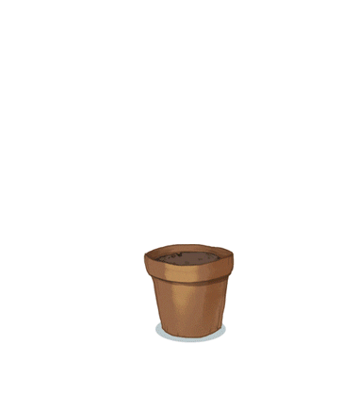


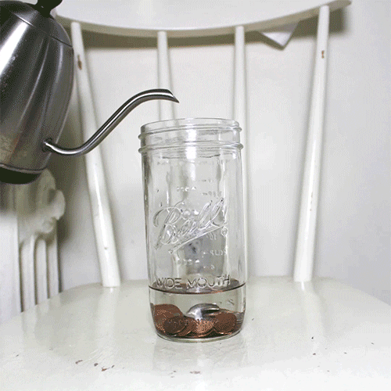
Important Factors in Growing Plants

Slide 4
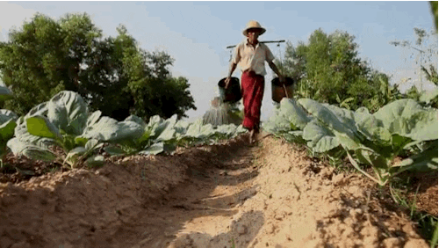
The Importance of Irrigation
In order for the plant to grow healthily, it must be in neither too much nor too little irrigated soil.

Slide 5
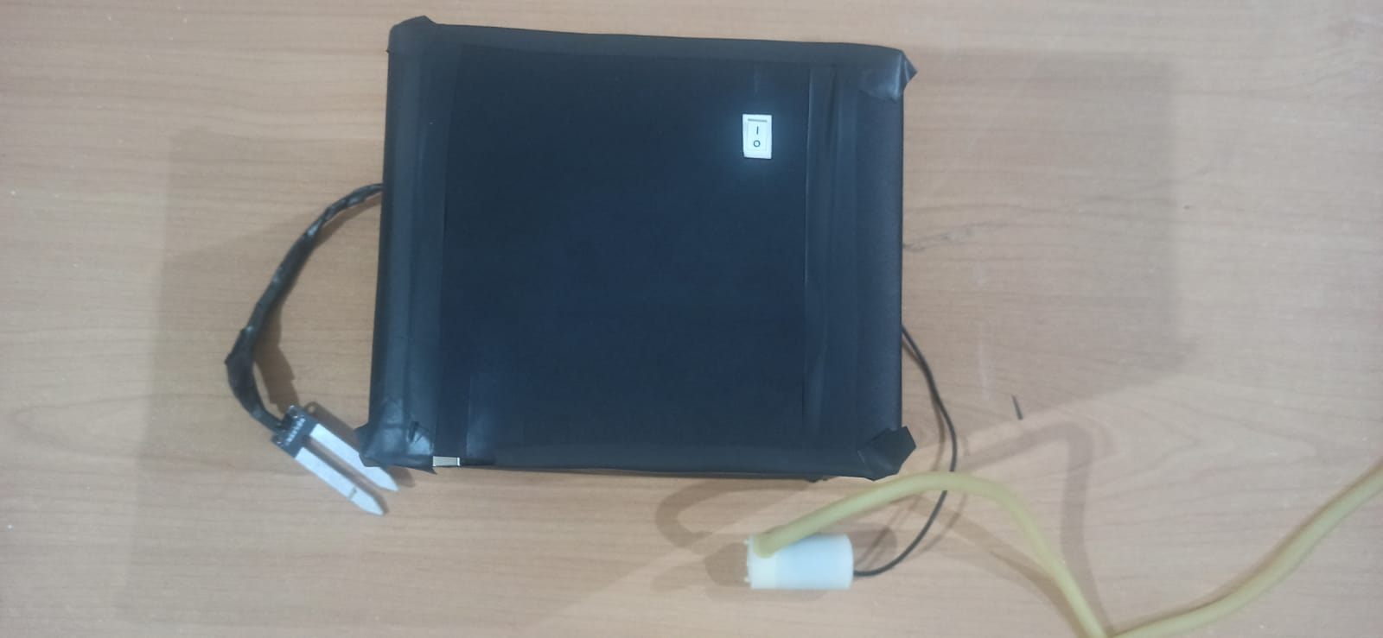
System Design
20 cm
Switch
15 cm
Charging Module
Arduino Uno
Step Up Regulator
3.7 V Li-ion Battery
Transistor
Soil Moisture Sensor
Water Pump

Slide 6
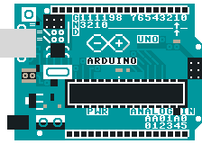
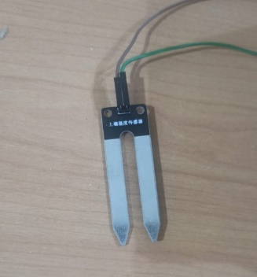
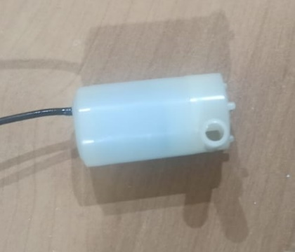
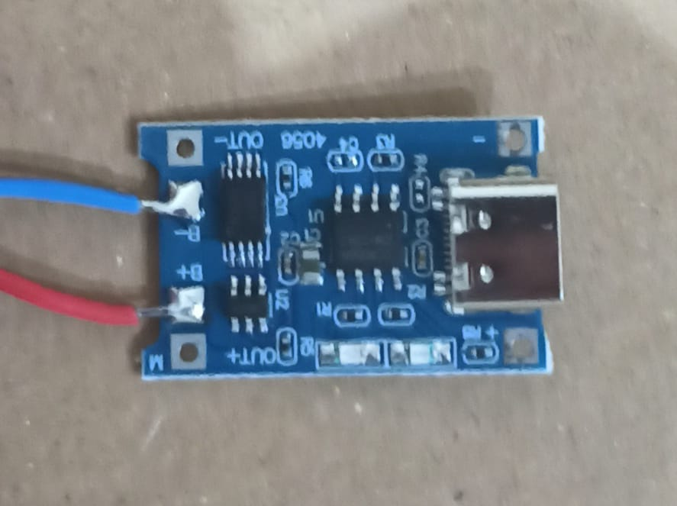
Proposed System

Slide 7
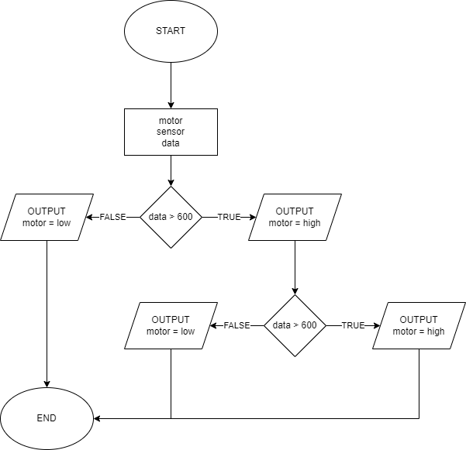
System Works

Slide 8
System Works
System Code: https://github.com/emreselenn/AUTOMATIC-PLANT-WATERER-PROJECT

Slide 9
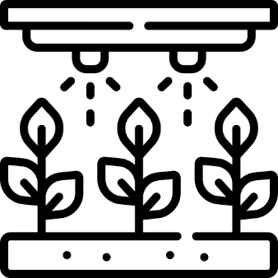


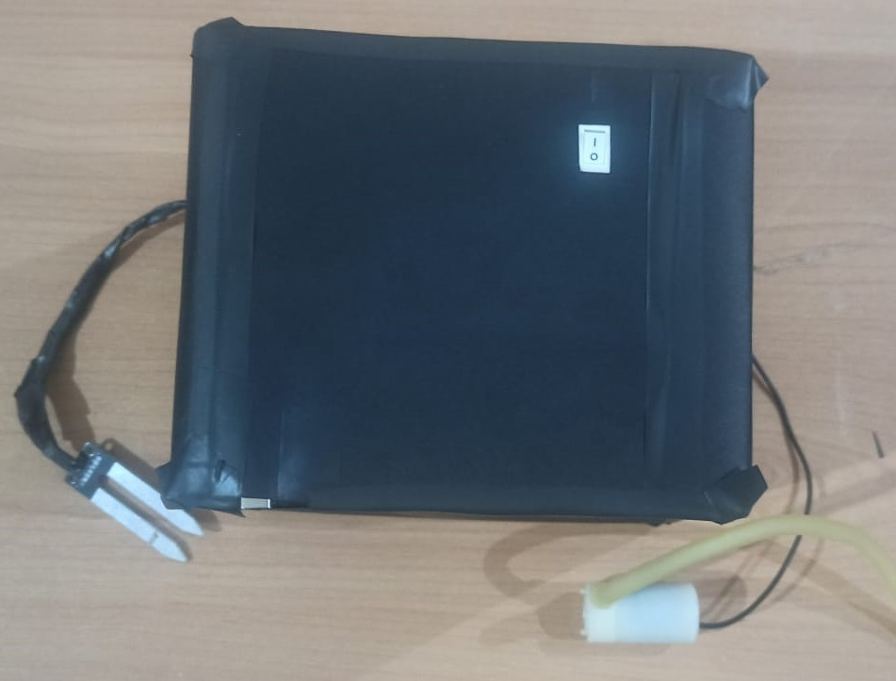



Conclusion
Waterer
Battery saving
Low cost
Portable
Compact
Open source

Slide 10
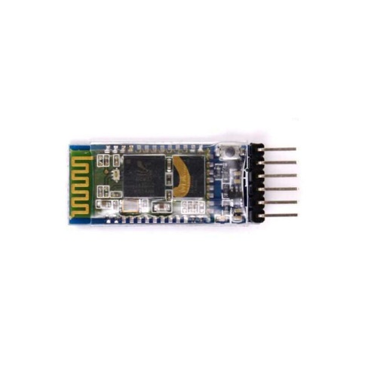
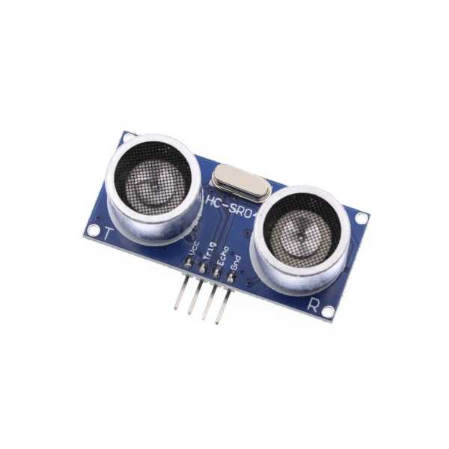
Future Works
https://www.robotistan.com/hc05-bluetooth-serial-modul-karti-hc05-bluetooth-to-serial-port-module-br
https://www.robolinkmarket.com/hc-sr04-arduino-ultrasonic-mesafe-sensoru?gclid=Cj0KCQiAt8WOBhDbARIsANQLp95eveDAm42WqdPGgl6grmJ68lXSeKnA1W9foeXWTvAmJA6_raHWotEaApjqEALw_wcB

Slide 11

THANKS FOR LISTENING
emreselen.915@gmail.com

